Slide 1
Fossils of the Southeast US DBMS project CSC 4710
Jeffrey Bruggeman
Kevin Seveur
Julio Soldevilla
Philipos Zegey
Notes:
We designed this template so that each member of the project team has a set of slides with its own theme. Members, here’s how you add a new slide to just your set:
Mark where you want to add the slide: Select an existing one in the Thumbnails pane, click the New Slide button, then choose a layout. The new slide gets the same theme as the other slides in your set.
Careful! Don’t annoy your fellow presenters by accidentally changing their themes. That can happen if you choose a different theme from the Design tab, which changes all of the slides in the presentation to that look.

Slide 2
Content of the presentation
Introduction
Requirements Analysis
Entity Relationship Diagram
Relational model
Functionalities
Summary and Conclusion

Slide 3
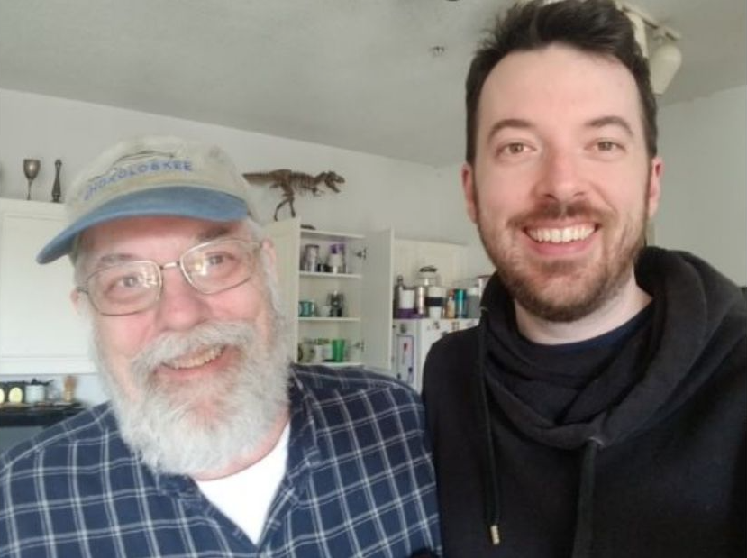
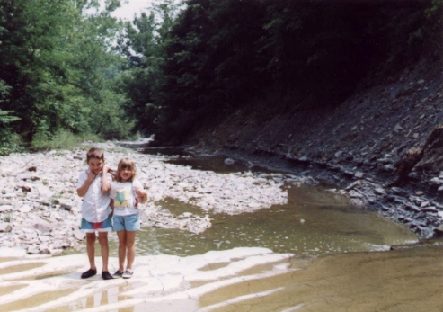
Introduction

Slide 4
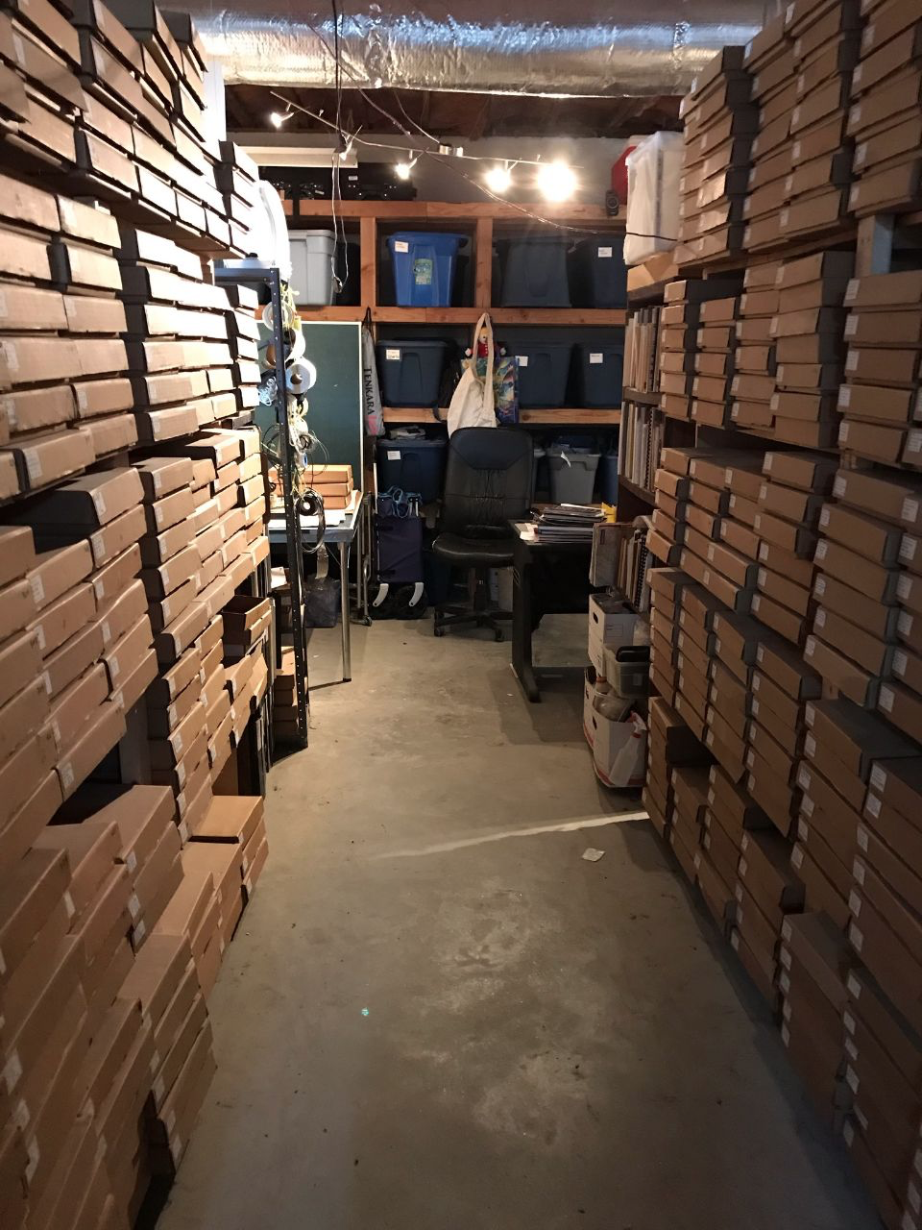
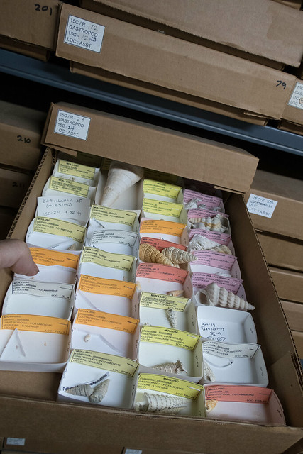
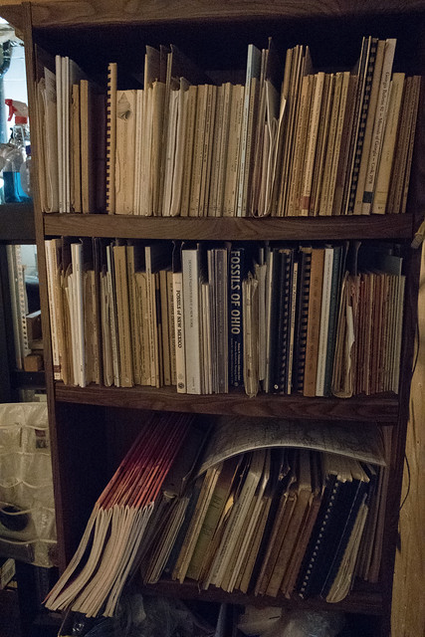
Introduction

Slide 5
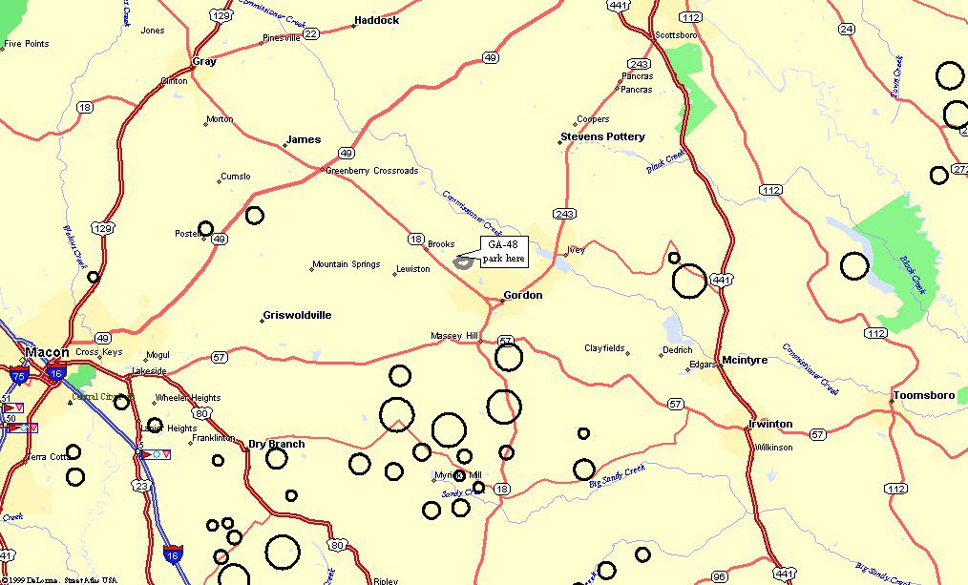
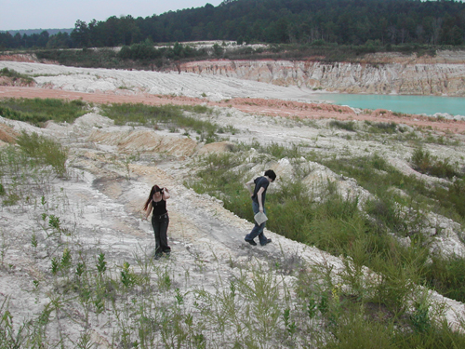
Introduction

Slide 6
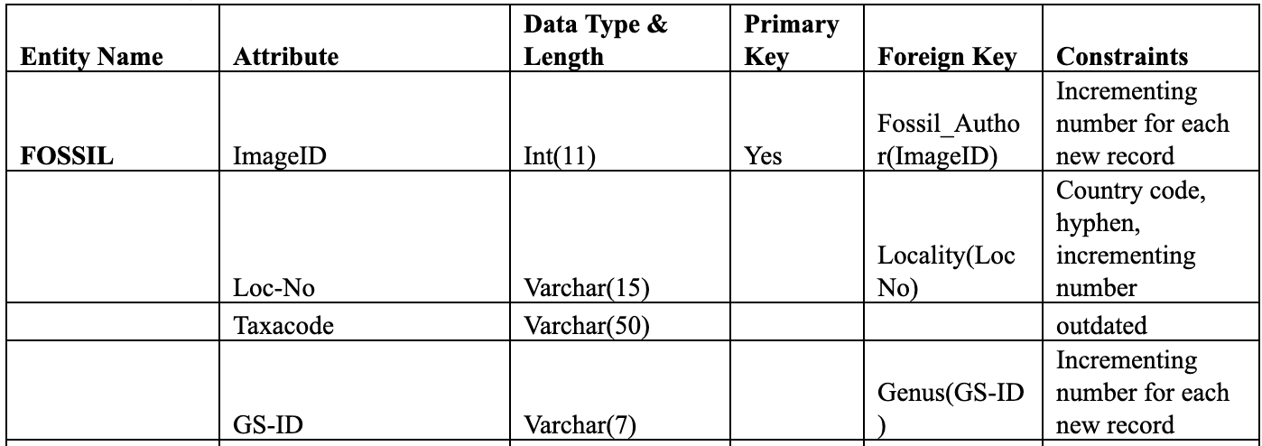
Requirements Analysis

Slide 7
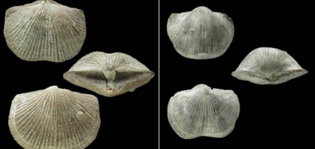
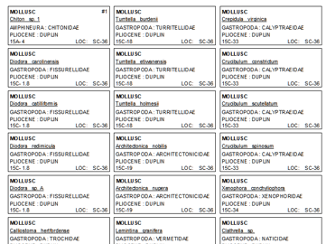
Requirements Analysis

Slide 8
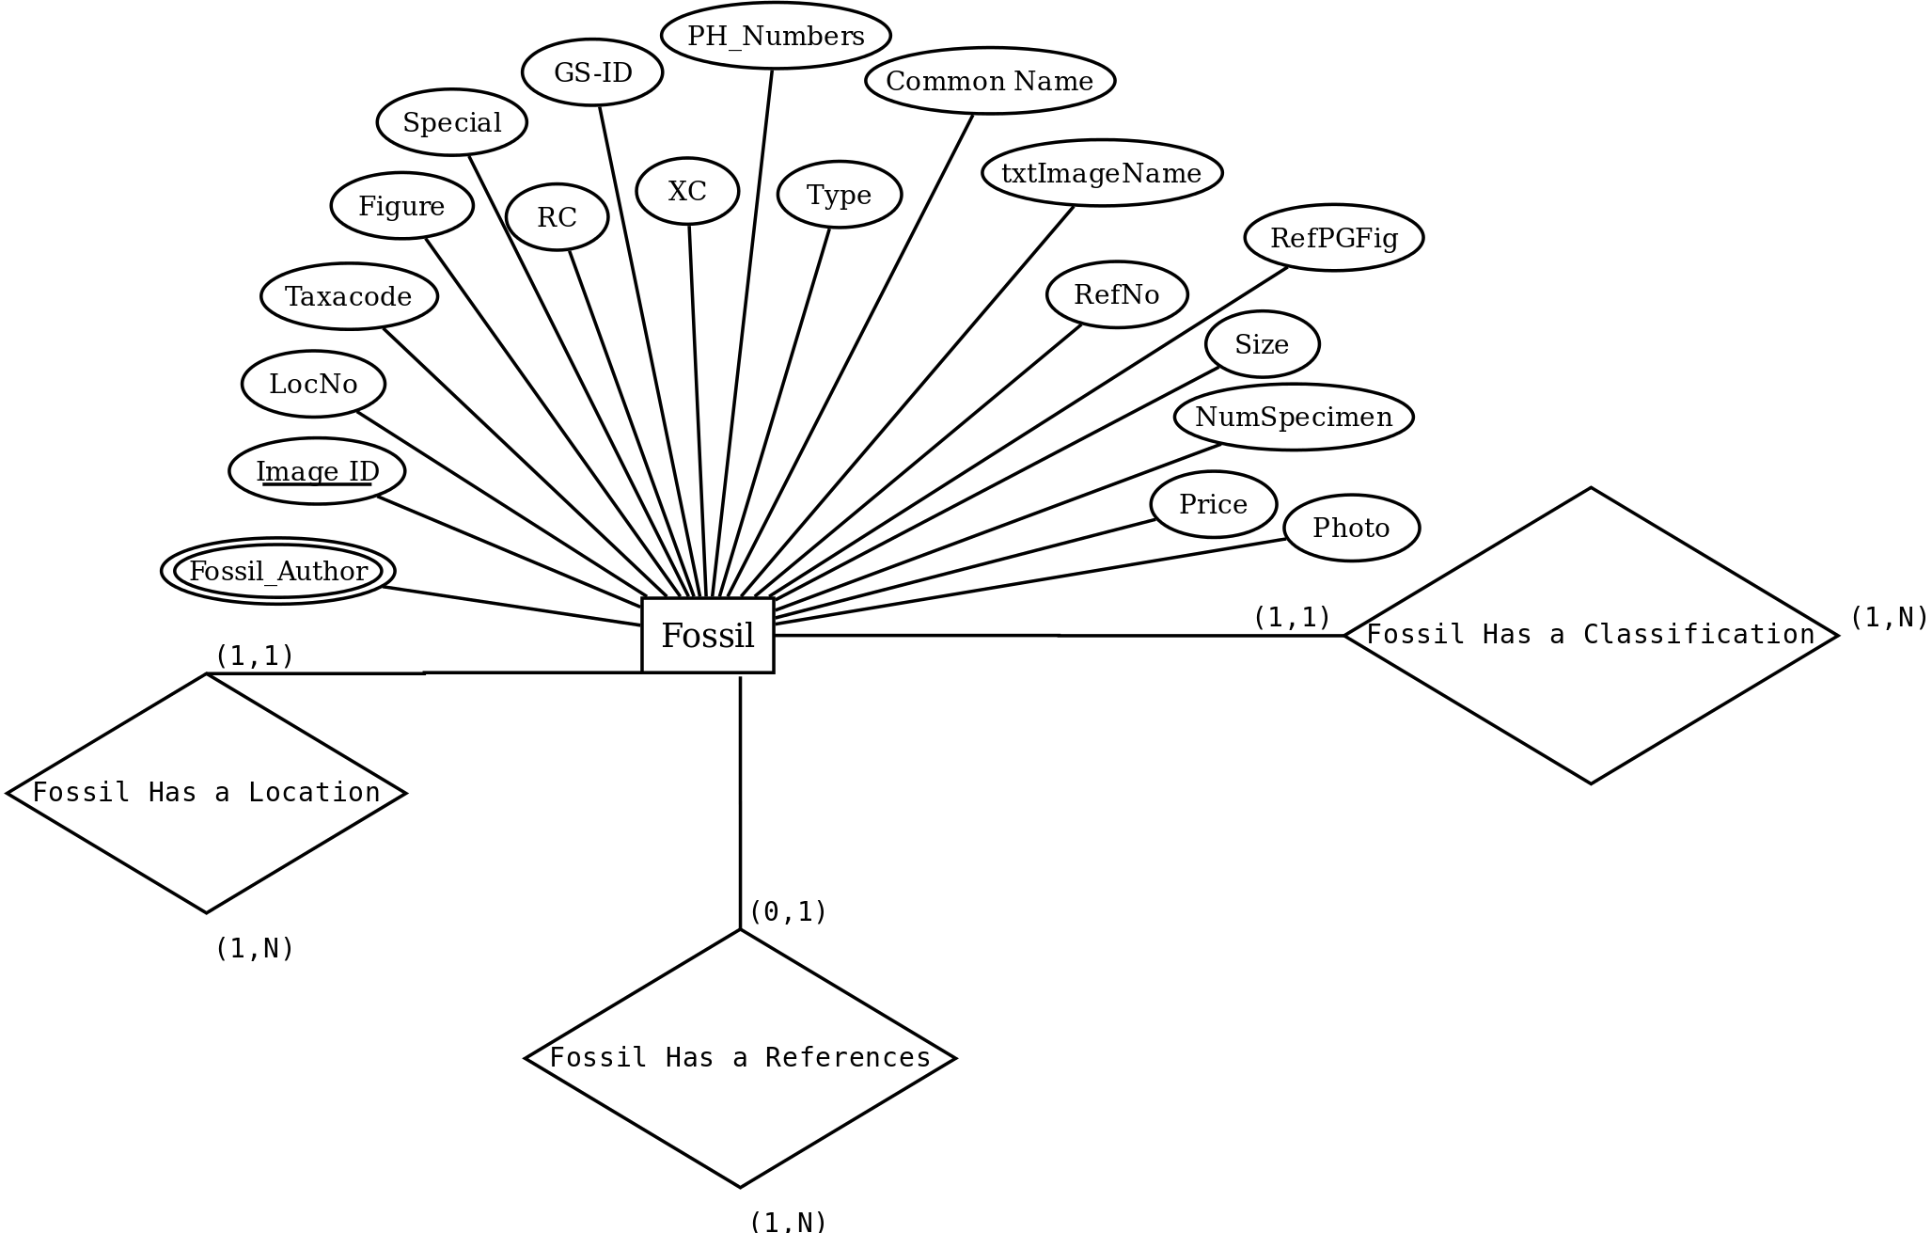
Entity Relationship Diagram

Slide 9
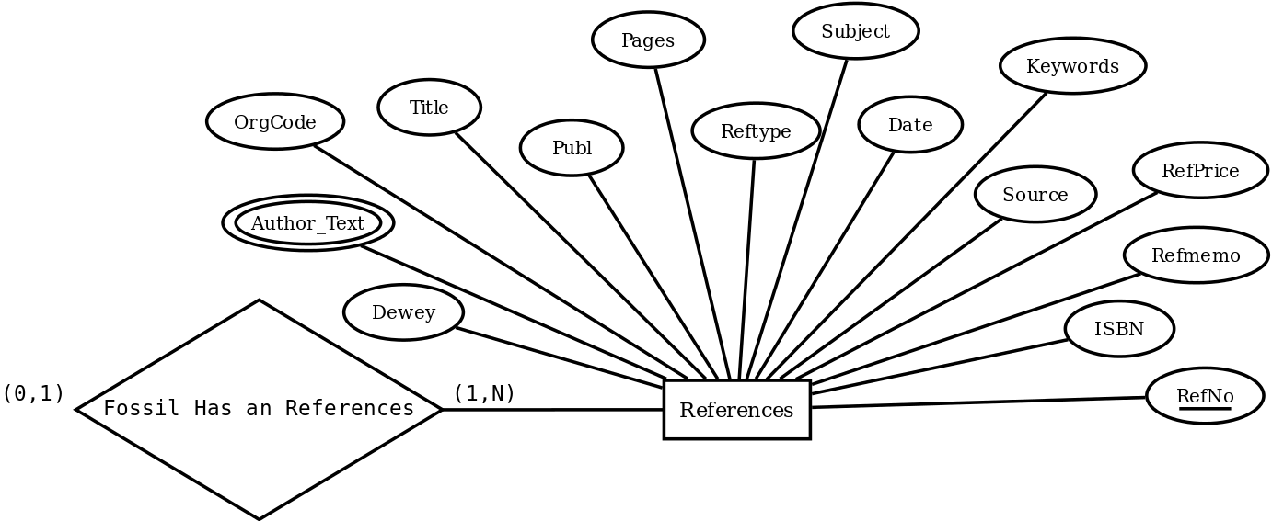
Entity Relationship Diagram

Slide 10
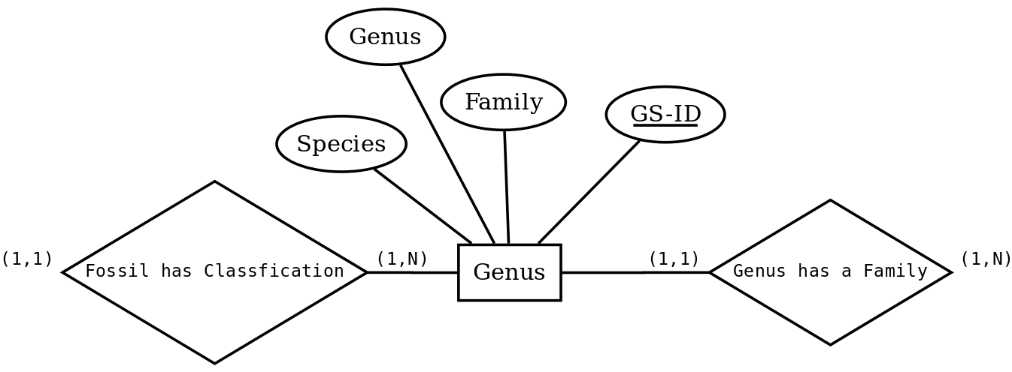
Entity Relationship Diagram

Slide 11
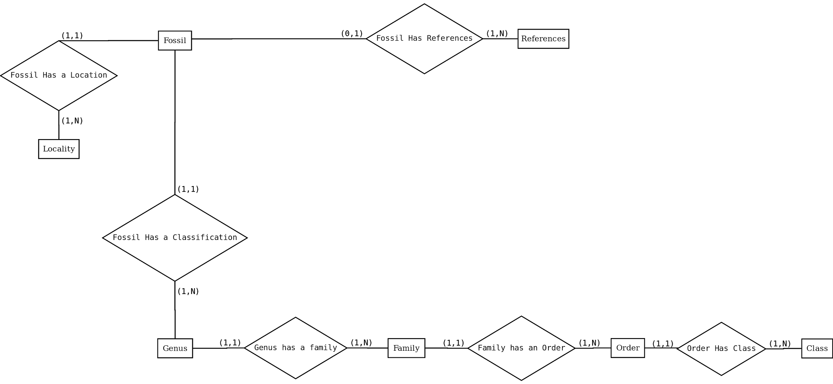
Entity Relationship Diagram

Slide 12
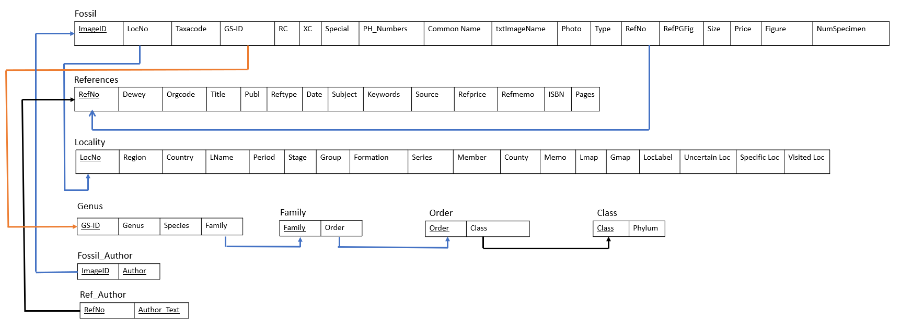
Relational Model
Notes:
triavl to map already in 3NF form, trouble mapping genus,

Slide 13
Functionalities
Function of the Database:
This fossil database allows us to use one of four attributes of the fossil entity to find every bit of information we have for the fossil in the entire database
How:
We configured the database so that the main entity, Fossil, is the central object of the database
Example Query:
How do you create an optional query?
WHERE A = option 1
#AND B = option 2
#AND C = option 3
;
Example Query:
How do you traverse a chain of entities analytically and efficiently?
Step 1 A JOIN B JOIN C JOIN D
Step 2 A.1 = B.1, B.2 = C.1, C.2 = D.1
A
B
C
D

Slide 14
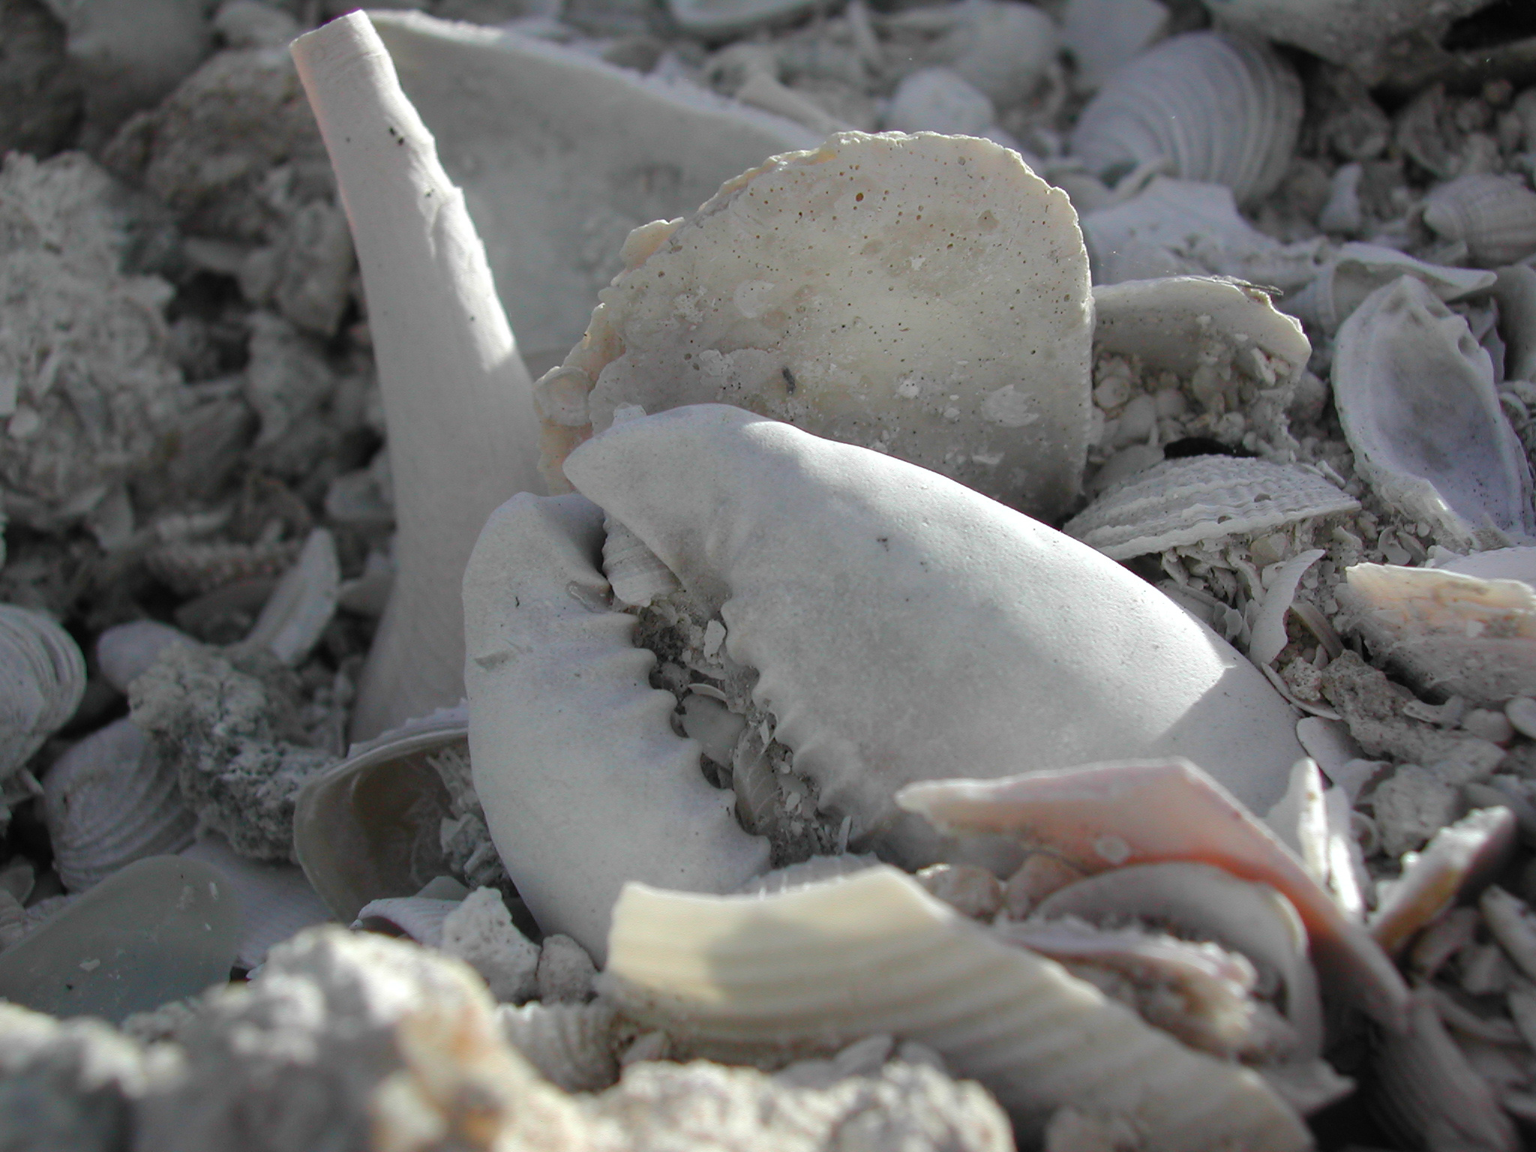
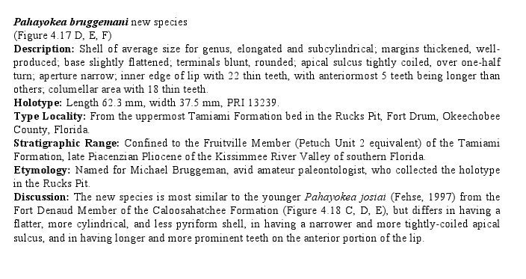
Summary and Conclusion

Slide 15
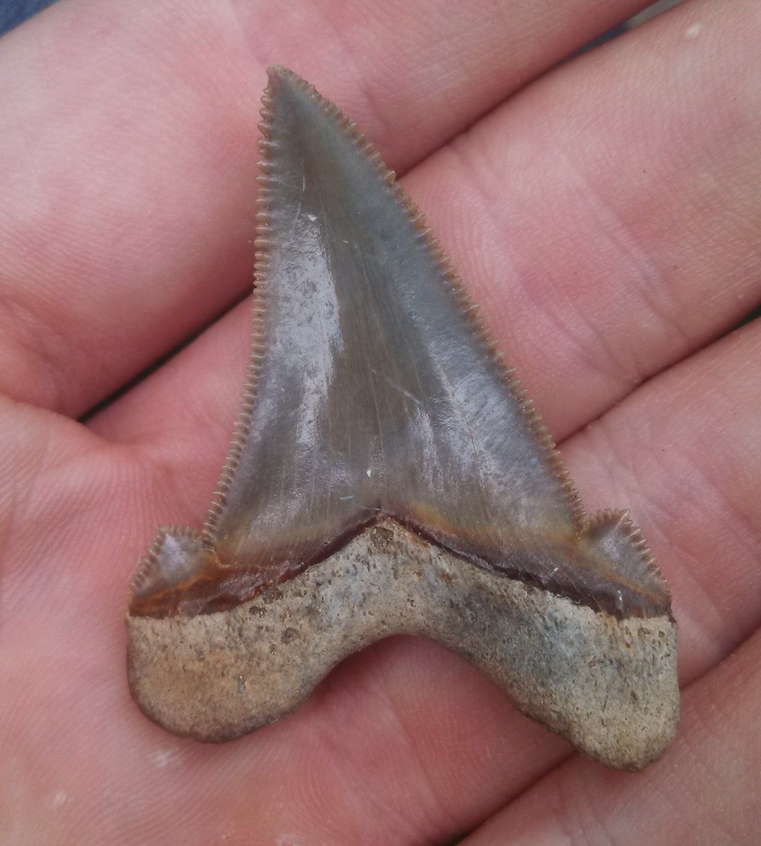
Summary and Conclusion
Discussion of difficulties and what we learned

